Slide 1
USGS (U.S Geological Survey) 23-12-22 – 23-01-2023
The Developer Academy
2023
Assignment 5 Cidalia Eusebio

Slide 2
Contents
Problem - Big Picture – Explore data - Get data – Preparation - Exploration & Insights
Assignment 5: USGS data
2

Slide 3
General Info data set
1 month of data from 23-12-22 – 23-01-2023
Explored data
Variables definition
Asked chat GTP relevant question that might be useful to explore
Explore and data cleaning
Assignment 5: USGS data
3

Slide 4
Key Definitions & Importance
Time
Latitude & Longitude
Depth
Mag
The date and time at which the earthquake occurred (in UTC time).
The geographic latitude or longitude of the earthquake's epicenter.
Depth of the earthquake's hypocenter (the point within the Earth where the seismic energy was first released). Measured in kilometers.
The magnitude of the earthquake, which is a measure of the earthquake's size. Different magnitude scales are used, such as Richter, Moment, and Local magnitude.
Understanding the temporal patterns of earthquakes and for analyzing the impact of an earthquake.
Understanding the spatial patterns of earthquakes and for determining the potential impact of an earthquake on nearby communities.
Understanding the tectonic processes that caused the earthquake, and for determining the potential impact of an earthquake at the surface.
Determining the potential impact of an earthquake on nearby communities, as well as for understanding the tectonic processes that caused the earthquake.
ADD A FOOTER
4

Slide 5
Key Definitions & Importance
MagType
nst
gap
dmin
The magnitude of the earthquake, which is a measure of the earthquake's size. Different magnitude scales are used, such as Richter, Moment, and Local magnitude.
The number of seismic stations that reported data for the earthquake.
The azimuthal gap, or the angular distance between the first station that reported data for the earthquake and the last station that reported data.
The minimum distance from the earthquake's epicenter to the nearest station reporting data for the earthquake. Measured in kilometers.
important for understanding the relative size of an earthquake and for comparing it to other earthquakes.
determining the accuracy of the earthquake's magnitude and location, and for understanding the distribution of seismic activity in a region.
determining the accuracy of the earthquake's location, and for understanding the distribution of seismic stations in a region.
understanding the distribution of seismic activity in a region
ADD A FOOTER
5

Slide 6
Key Definitions & Importance
rms
net
id
place
The root-mean-square (RMS) error of the arrival time data used to determine the earthquake's location and magnitude.
The network that reported the earthquake.
A unique identifier for the earthquake event.
The name of the location where the earthquake occurred
determining the accuracy of the earthquake's location and magnitude.
ADD A FOOTER
6

Slide 7
Key Definitions & Importance
type
horizontalError,
depthError,
magError
magNst
Status
locationSource, magSource:
The type of the event
These parameters are used to estimate the uncertainty of the location and magnitude of the event.
The number of stations used to compute the magnitude.
The status of the event, it can be reviewed or automatic
The source of the information
ADD A FOOTER
7

Slide 8
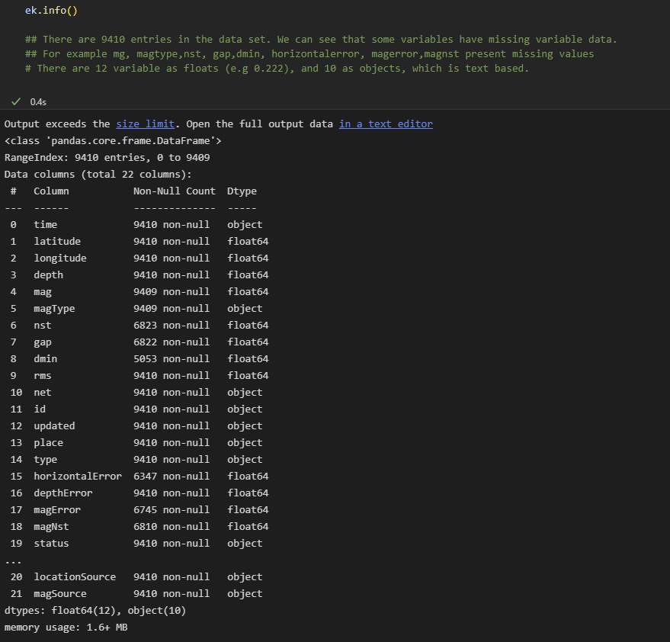
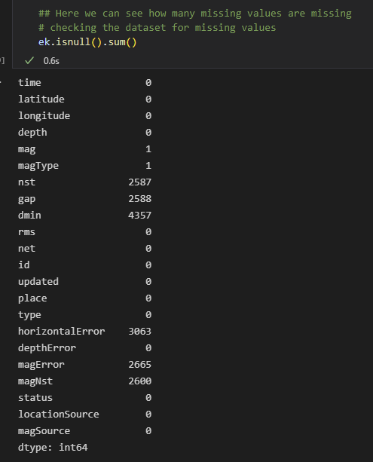
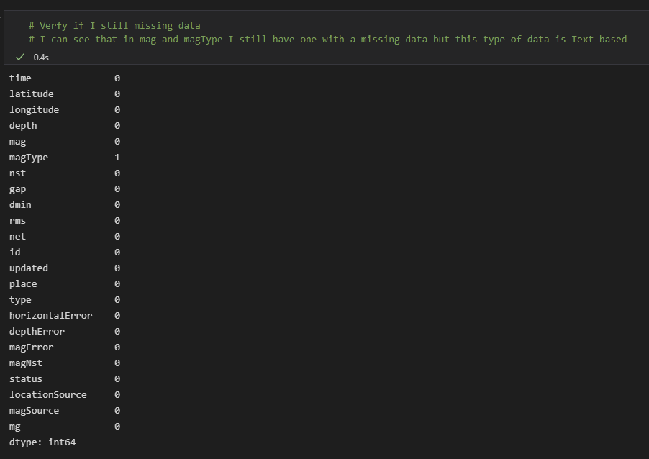
Data Information
9410 entries | Missing data | Different datatypes
Cleaning
ADD A FOOTER
8

Slide 9
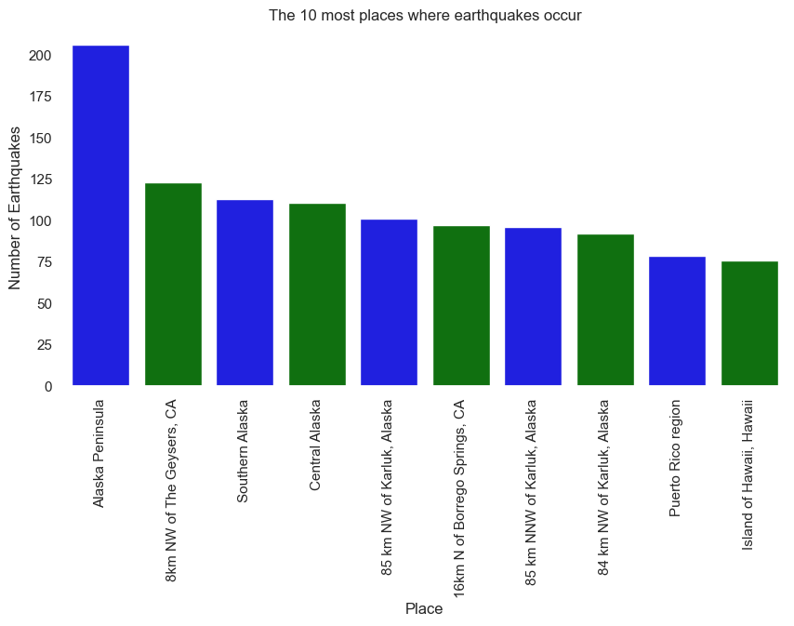
Alaska Peninsula is where most earthquakes occur over the last 30 days
Alaska has a high prevalence of earthquakes
9
Bar Graph | Pie Chart | Box Plot | Line Chart | Scatter Plot

Slide 10
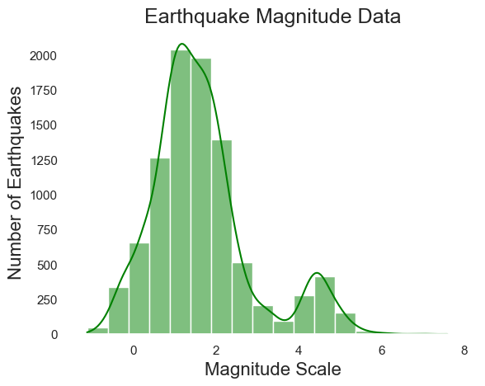
Majority of the Earthquake were micro-earthquakes
Micro-earthquakes (<2.5, not felt by humans)
There are earthquakes with Negative magnitudes but are rare
Almost no significant earthquakes >6
10
Bar Graph | Pie Chart | Box Plot | Line Chart | Scatter Plot

Slide 11
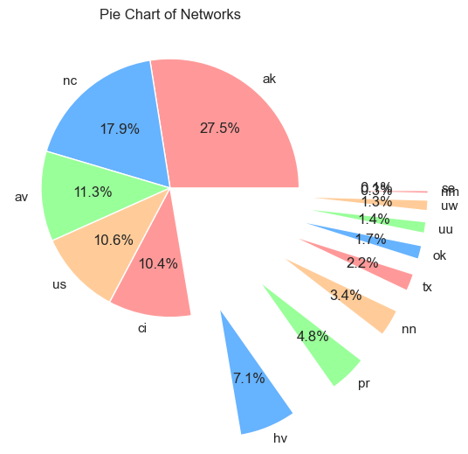
AK reported 28% of the earthquakes
Followed by NC (18%)
This might be due to the location of the majority of earthquakes
11
Bar Graph | Pie Chart | Box Plot | Line Chart | Scatter Plot

Slide 12
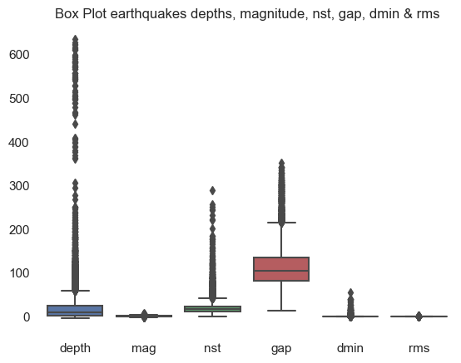
Several characteristics present outliers - ?rare phenomenon
12
Bar Graph | Pie Chart | Box Plot | Line Chart | Scatter Plot

Slide 13
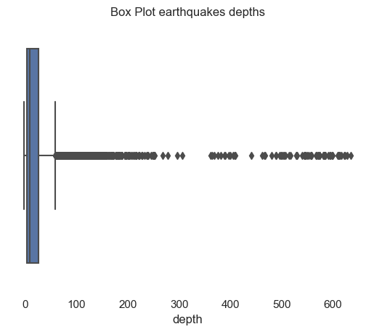
Having depths above 100 are rare
As majority are micro-earthquakes it makes sense that the depth is small
13
Bar Graph | Pie Chart | Box Plot | Line Chart | Scatter Plot

Slide 14
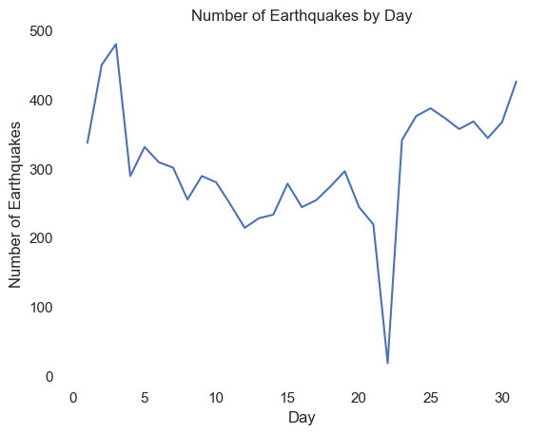
Earthquakes occur daily
Day 22 were only 18 registers earthquakes
This was on the 12th January
Reason: unknown
Bar Graph | Pie Chart | Box Plot | Line Chart | Scatter Plot
14

Slide 15
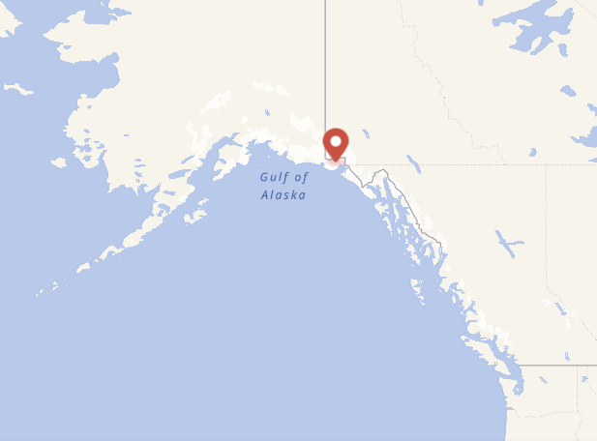
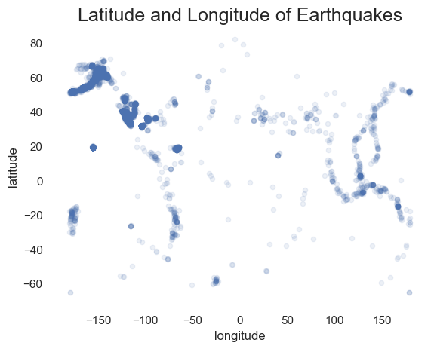
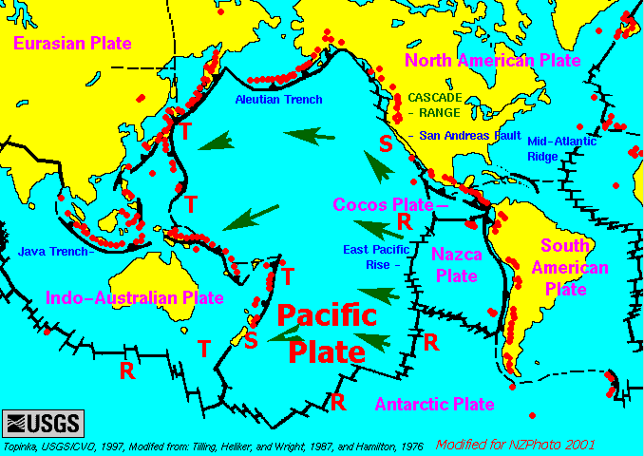
There are areas where earthquakes occur more often
Prevalent areas are around Gulf of Alaska
Alaska is near the intersection of two great plates: the Pacific Plate, beneath the Pacific Ocean, and the North American Plate.
Bar Graph | Pie Chart | Box Plot | Line Chart | Scatter Plot
15

Slide 16
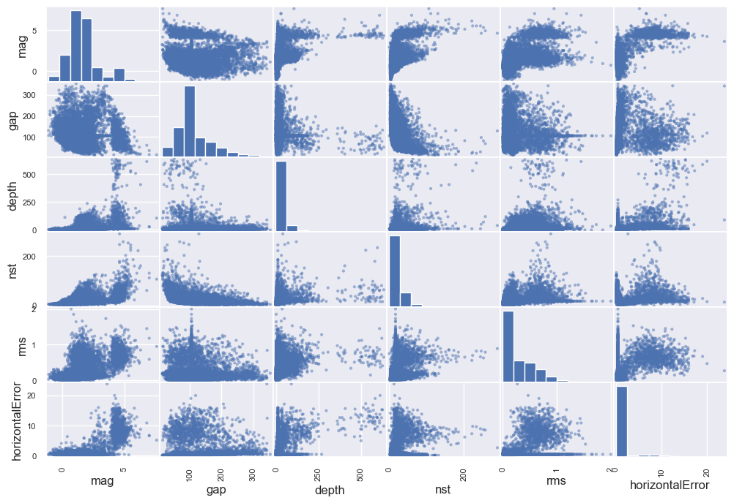
Other insights
Correlations
ADD A FOOTER
16

Slide 17
THANK YOU!

